Slide 1


Bayesian Analysis of PGA Golf Scores with Stan Part I Jamie Bernardin – September 2017

Slide 2
Agenda
Basic Golf Score Stats
Multi-level Model of Scores and Tournaments
Stokes Gained Intro and Score Regression
Time Series Modeling of Strokes Gained
Putting it all Together: Predictive Score Model
Analysis and Next Steps
Appendix – Data Preparation

Slide 3
Basic Score Analysis

Slide 4
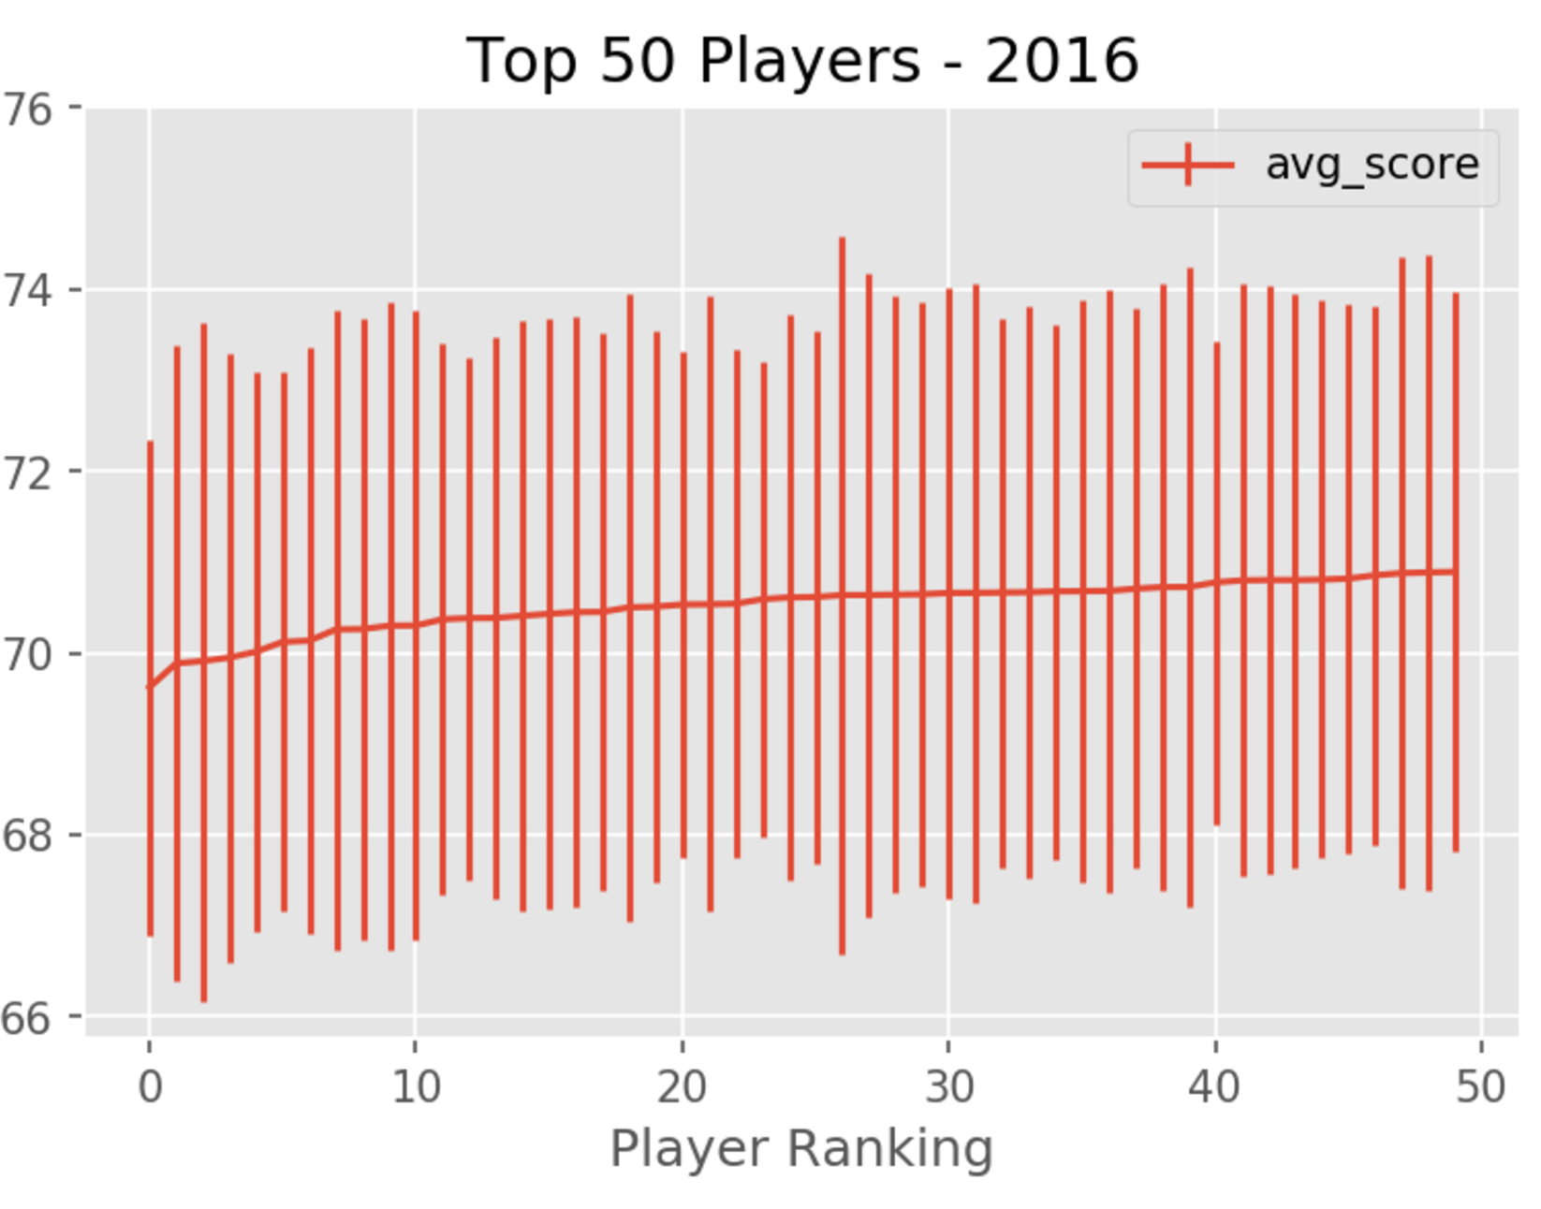

Slide 5
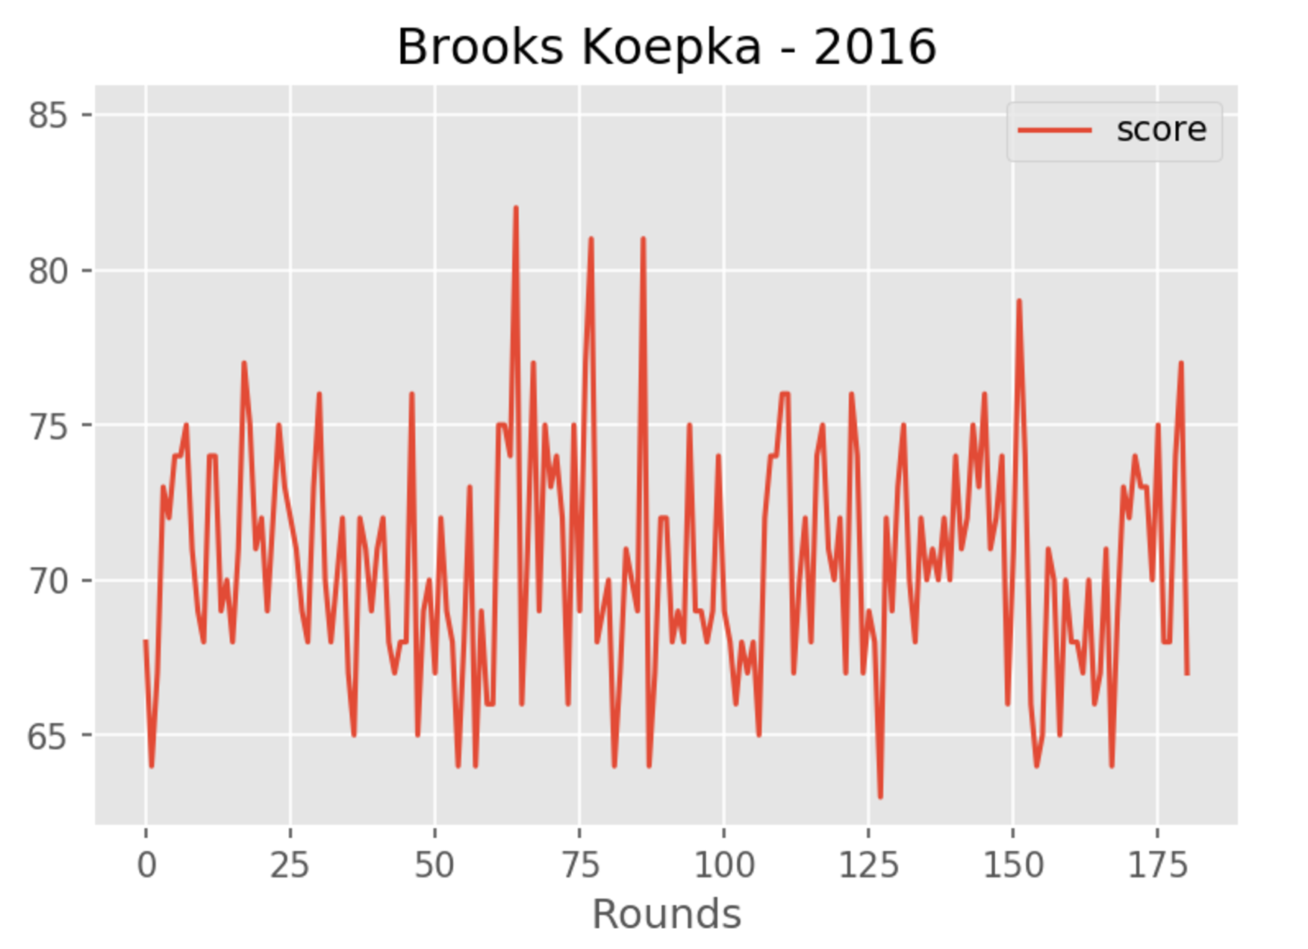

Slide 6
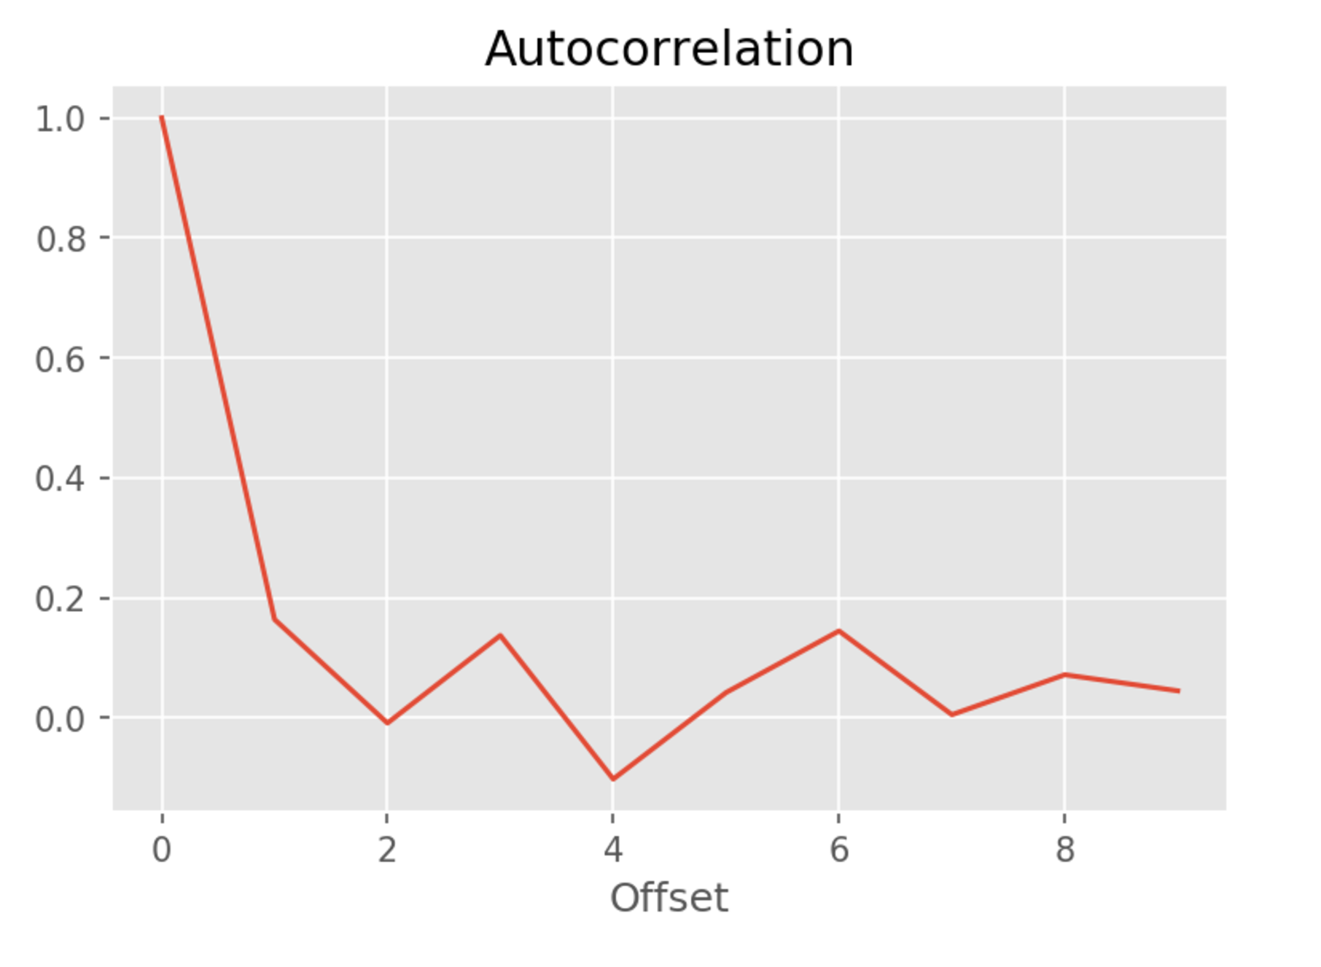

Slide 7
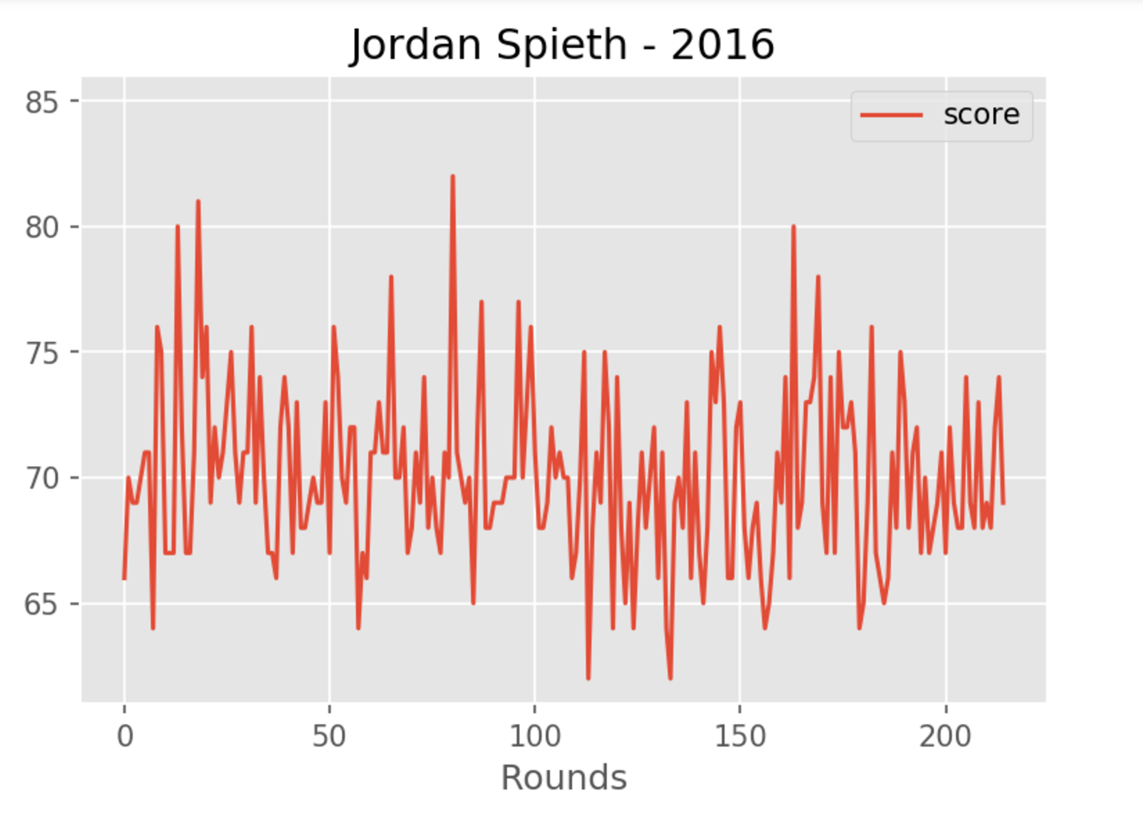

Slide 8
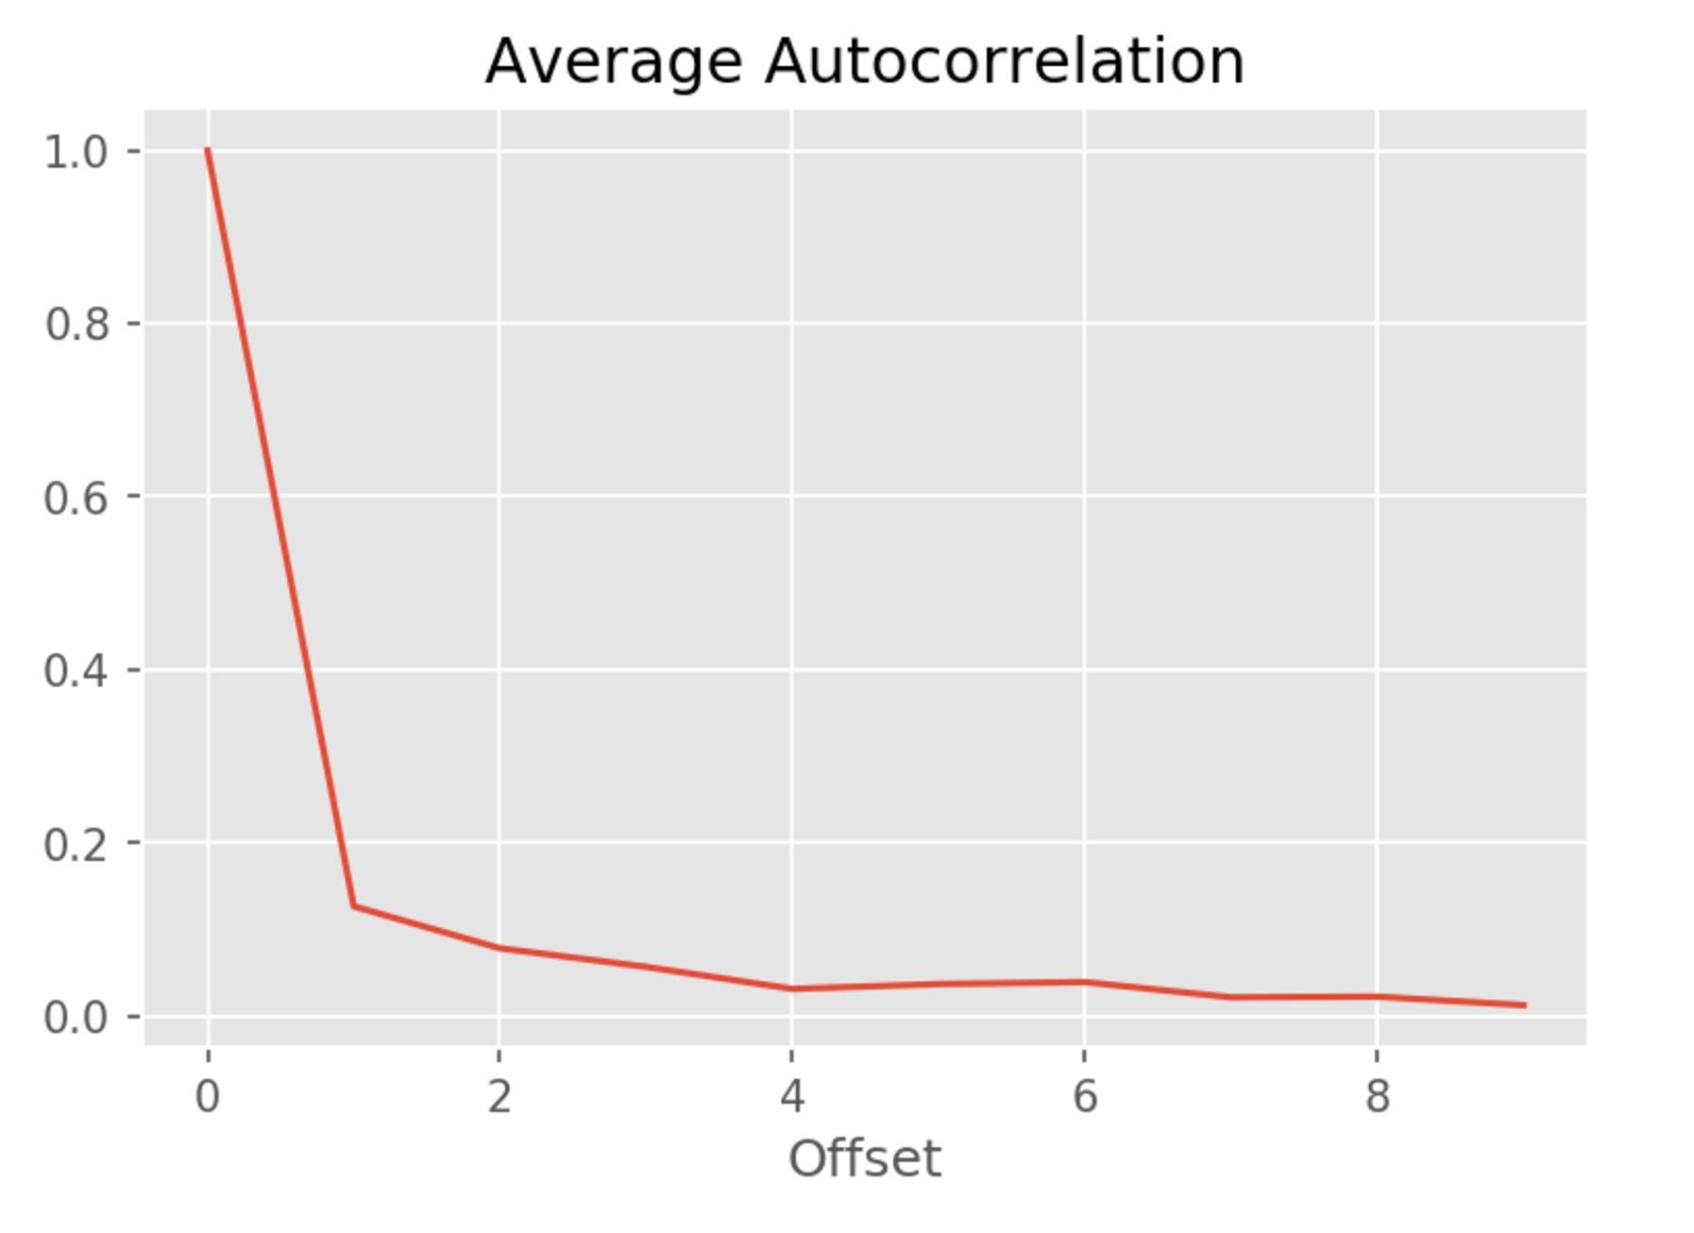

Slide 9
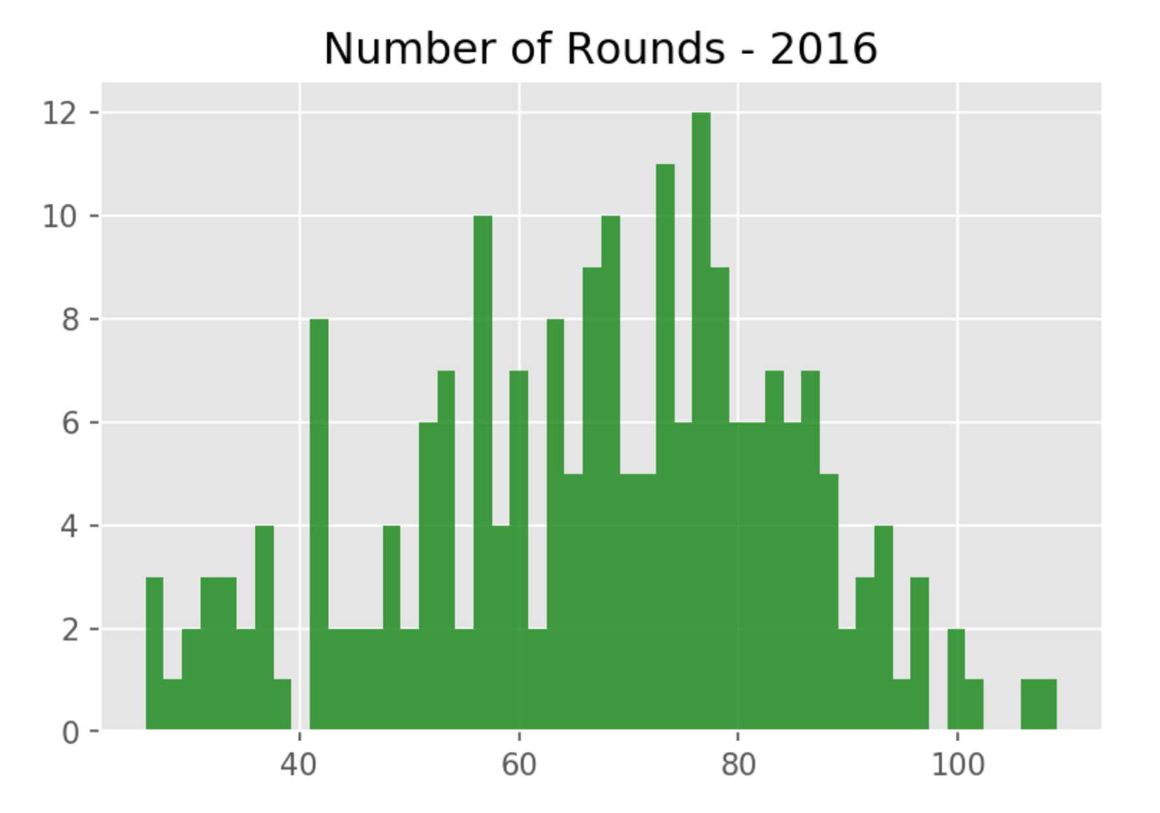

Slide 10
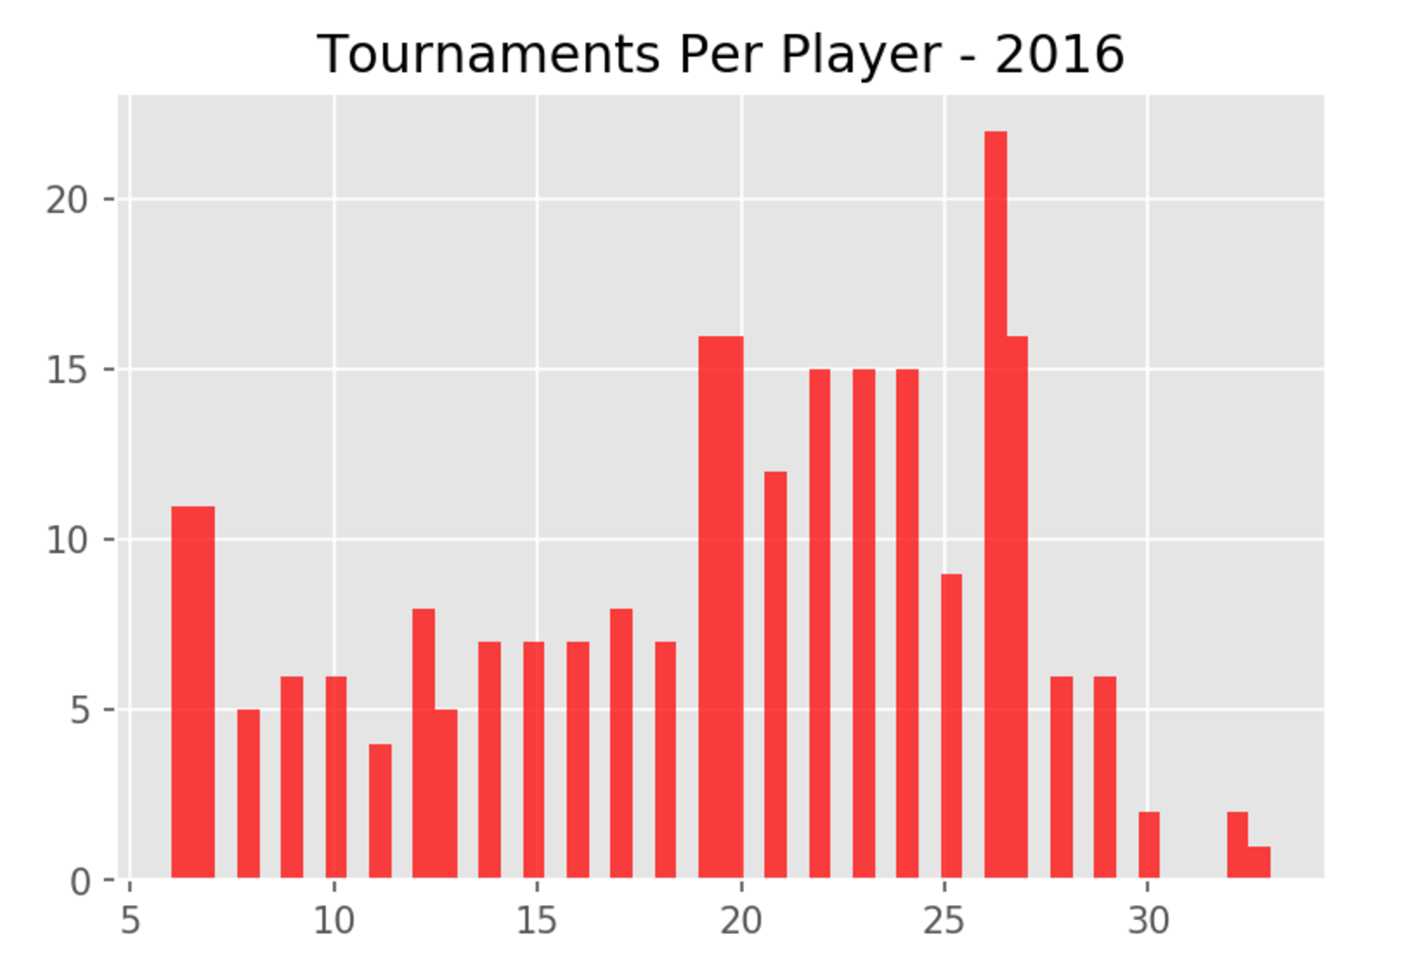

Slide 11
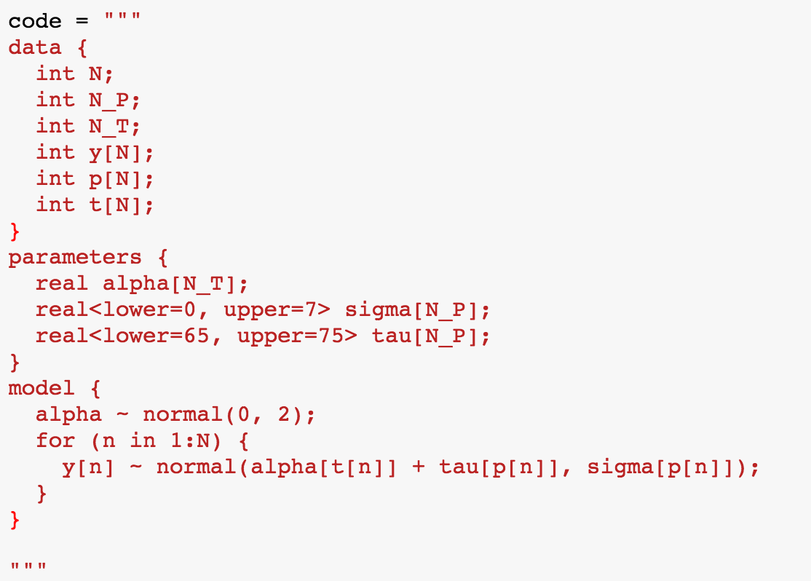
Multi-Score Model

Slide 12
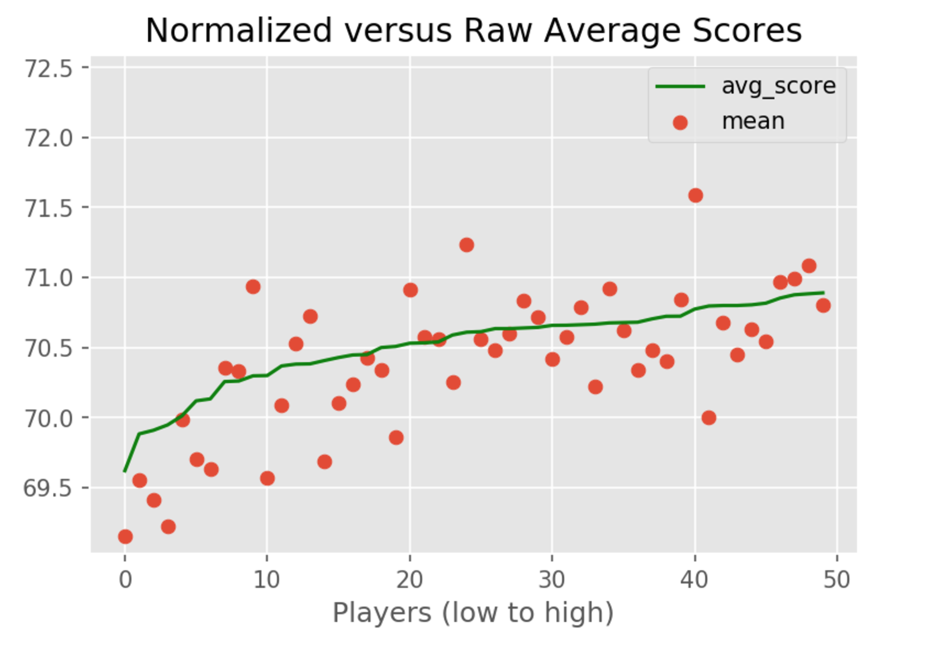

Slide 13
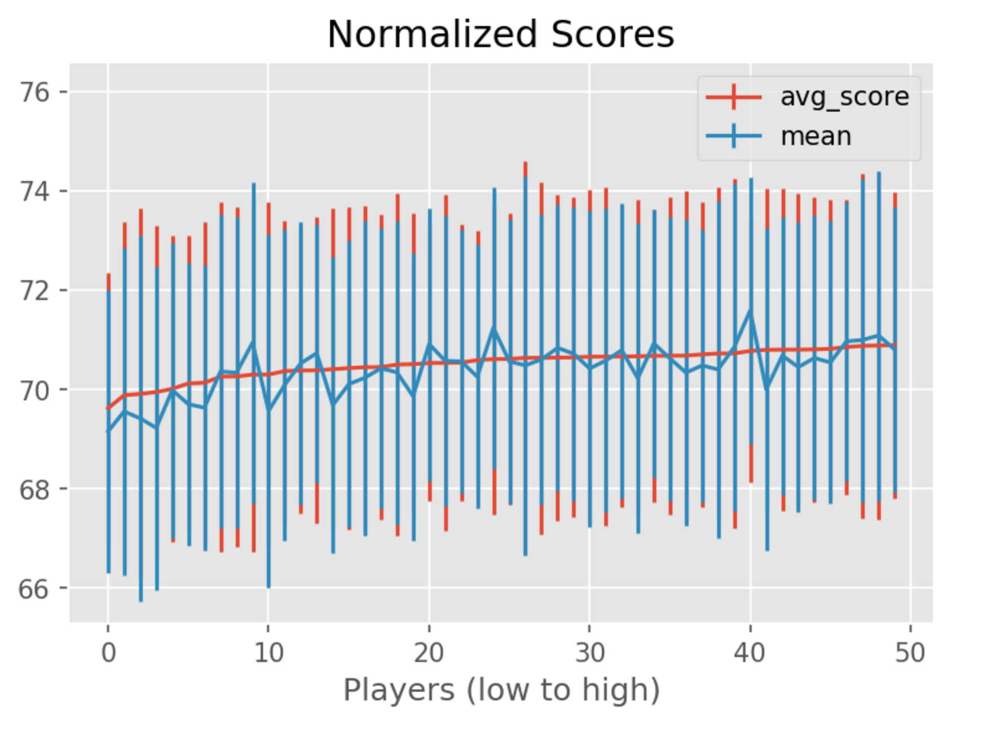

Slide 14
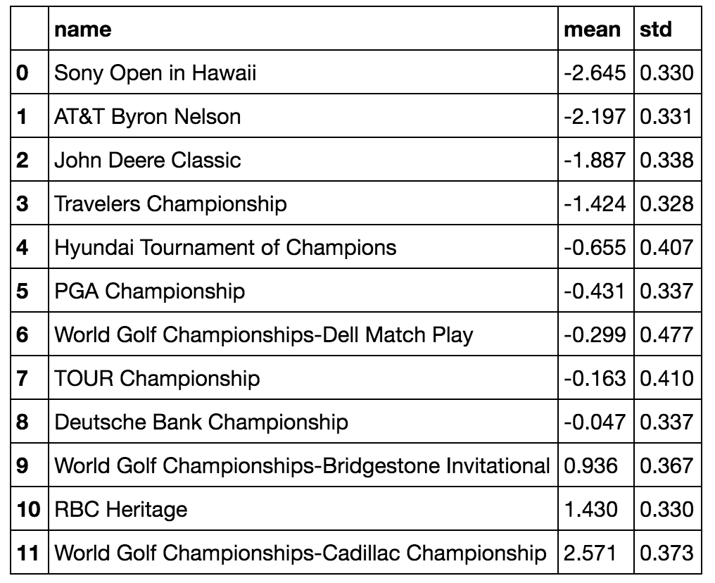

Slide 15
Strokes-Gained Analysis

Slide 16
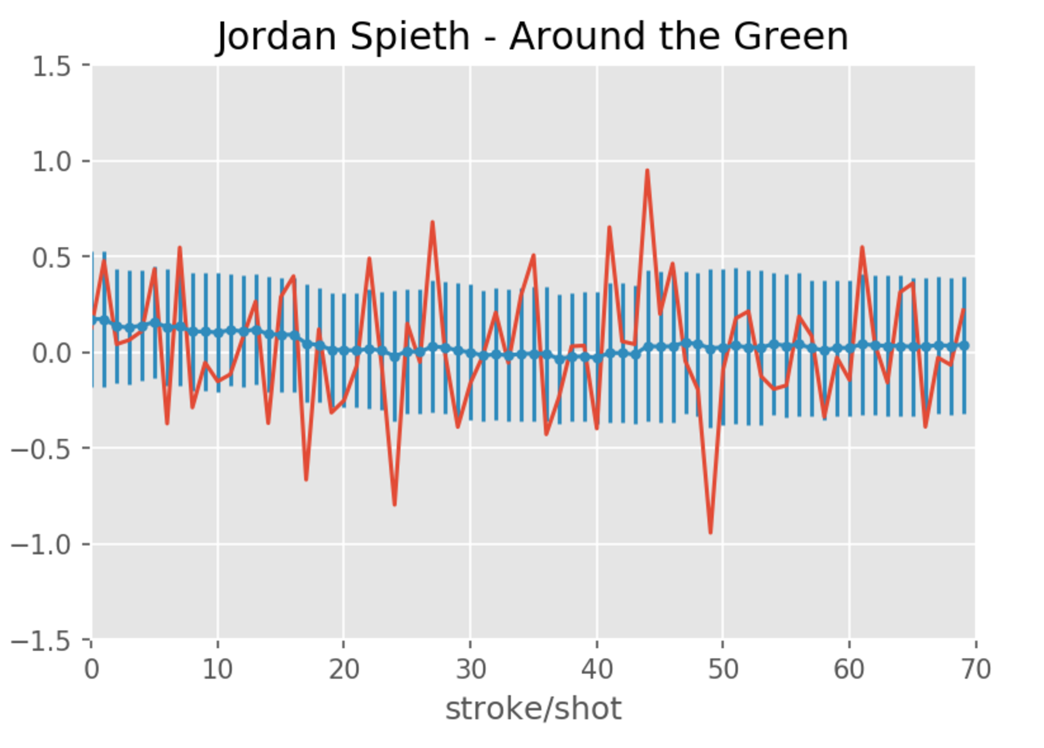
Strokes-Gained Analysis

Slide 17
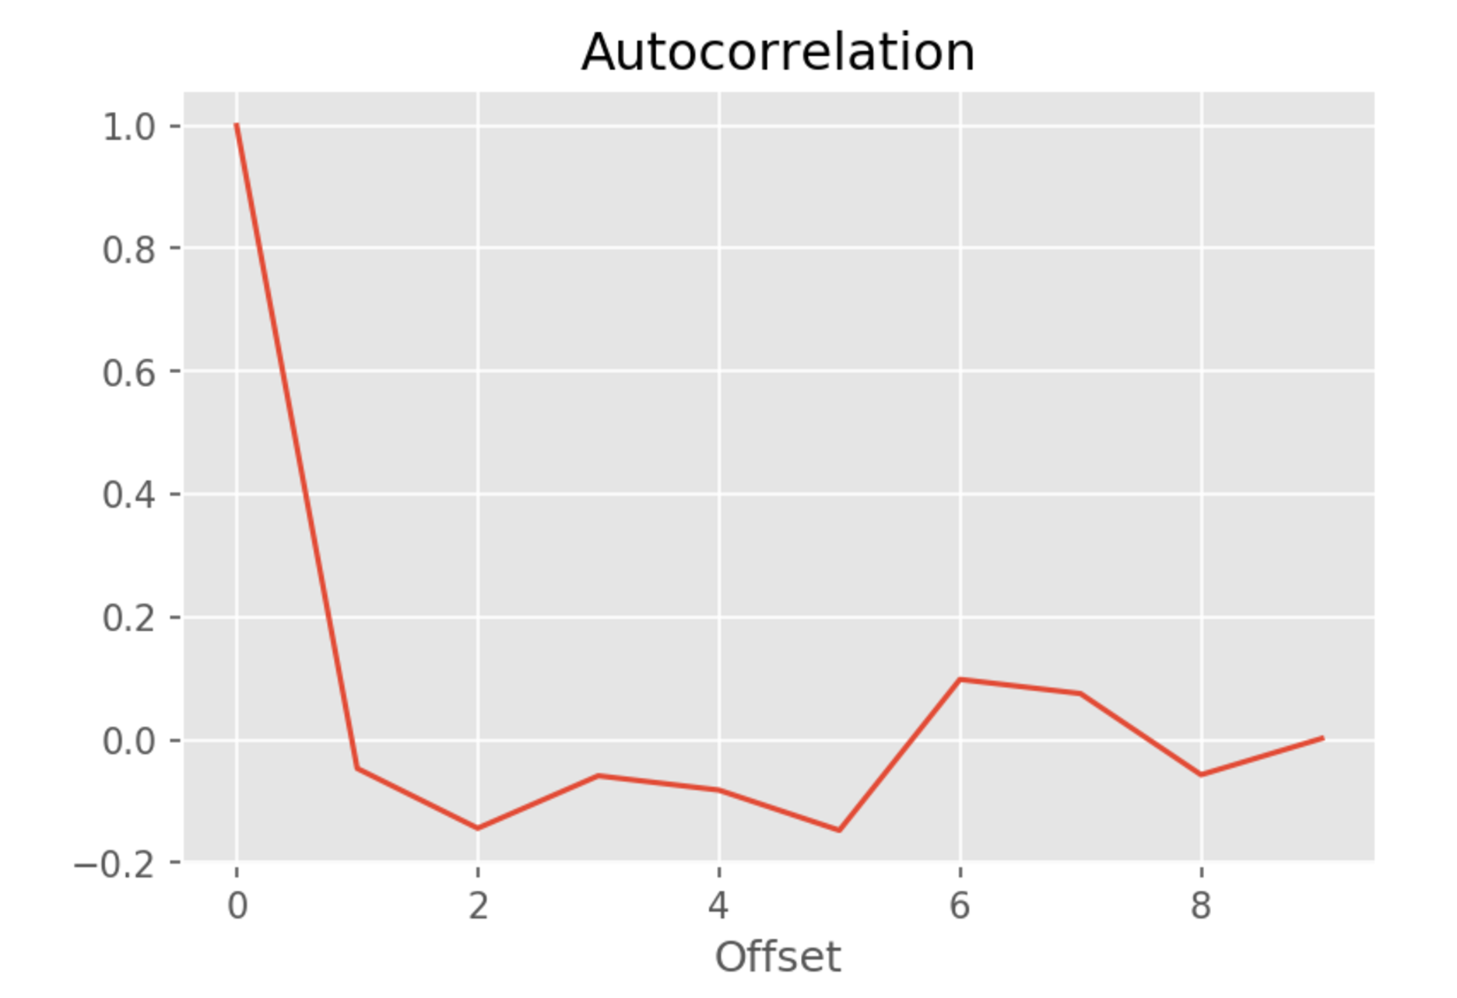
Strokes-Gained Analysis

Slide 18
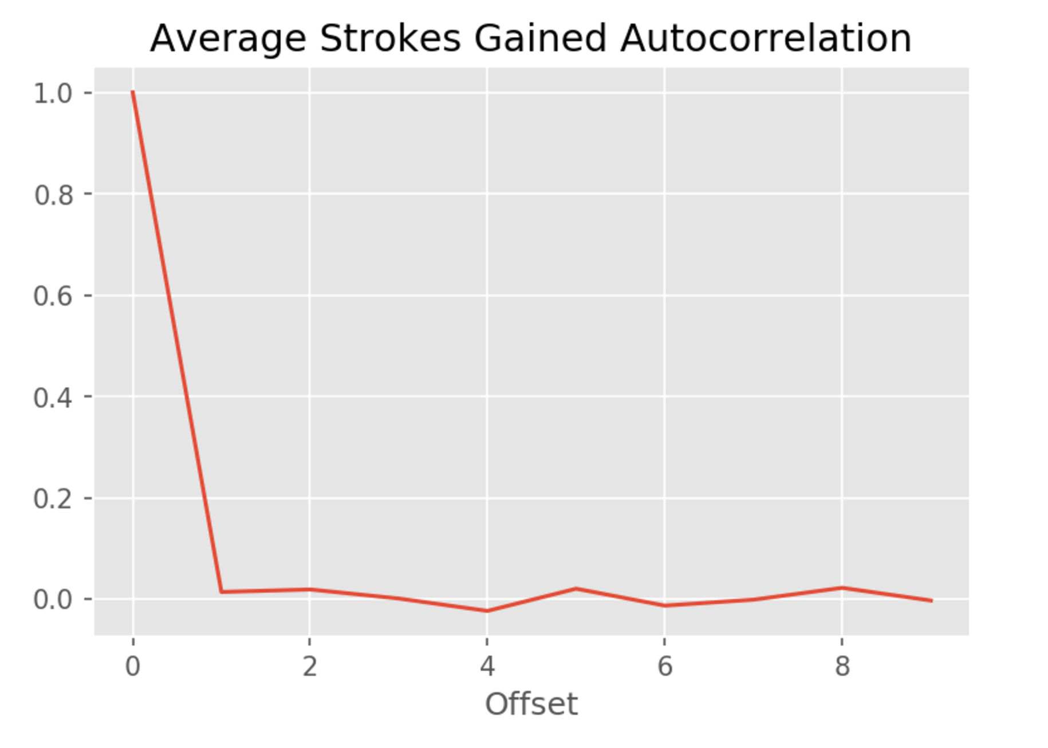
Strokes-Gained Analysis

Slide 19
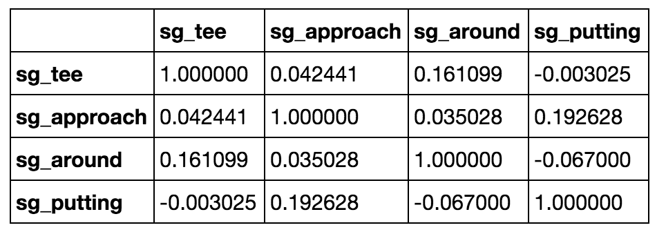
Strokes-Gained Analysis

Slide 20
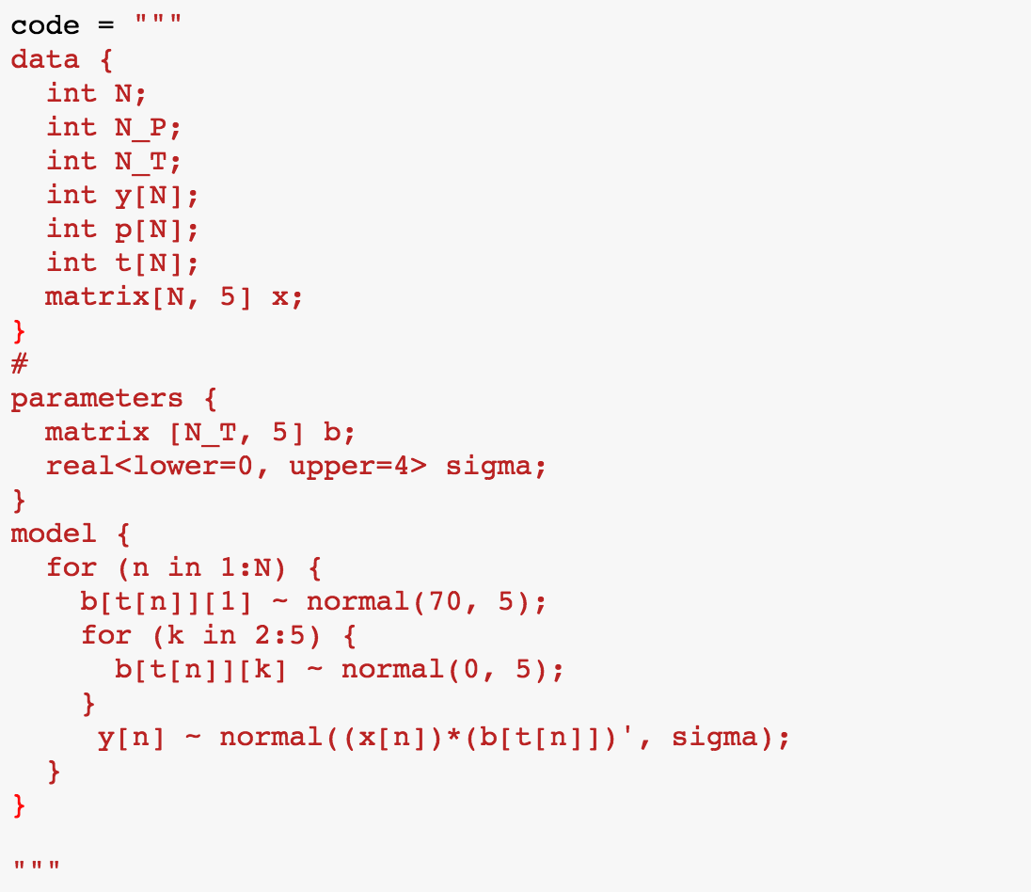
Strokes-Gained Regression

Slide 24
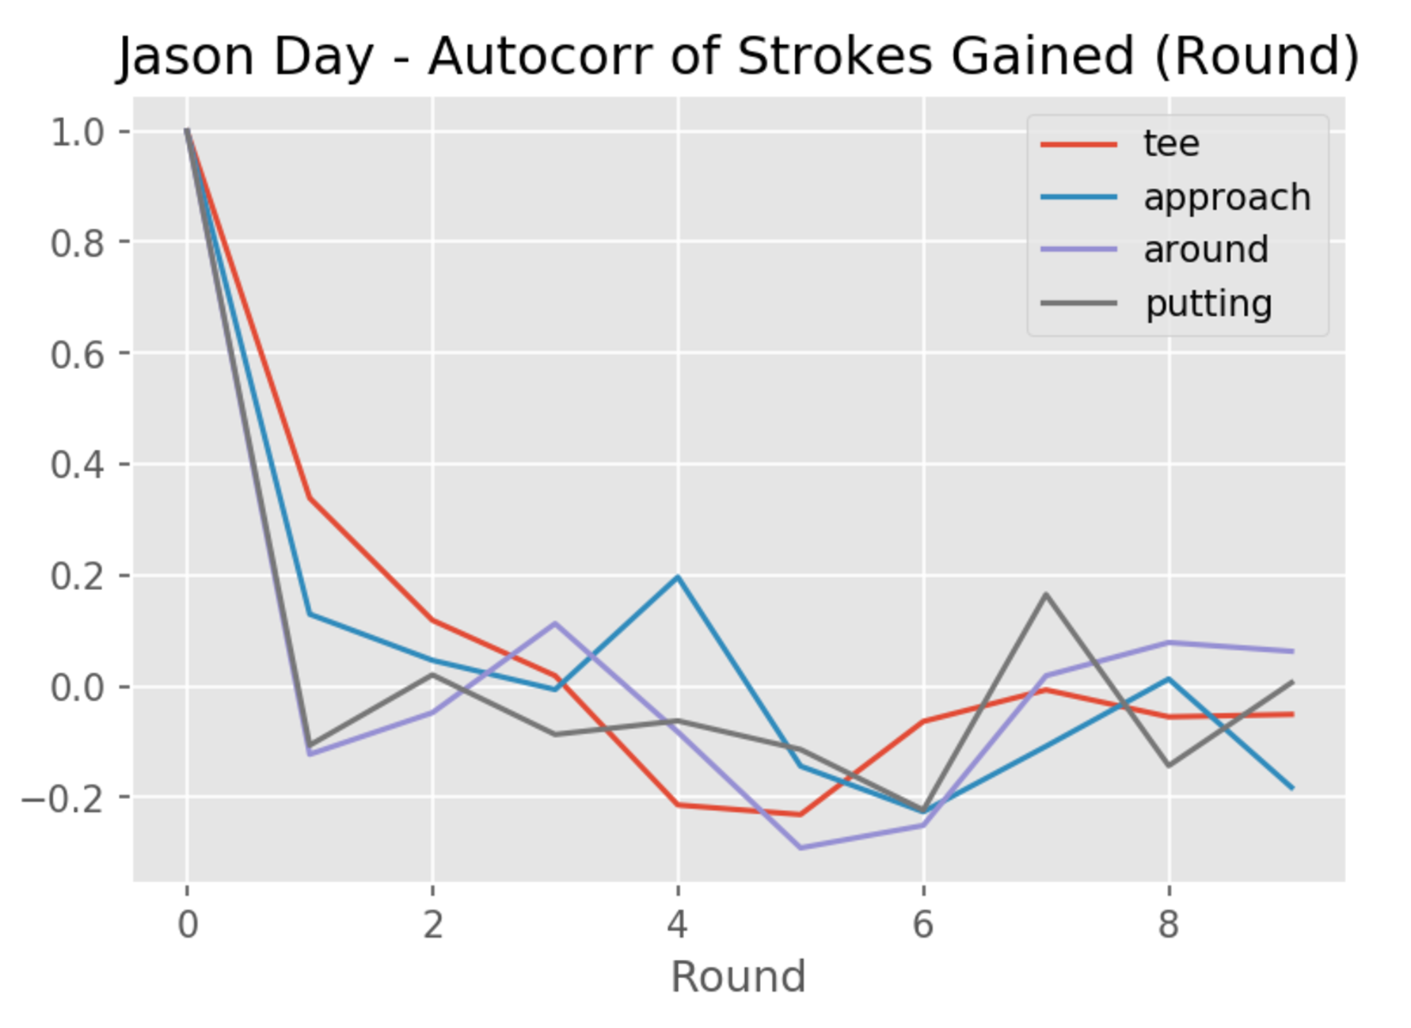
Strokes-Gained Analysis

Slide 25
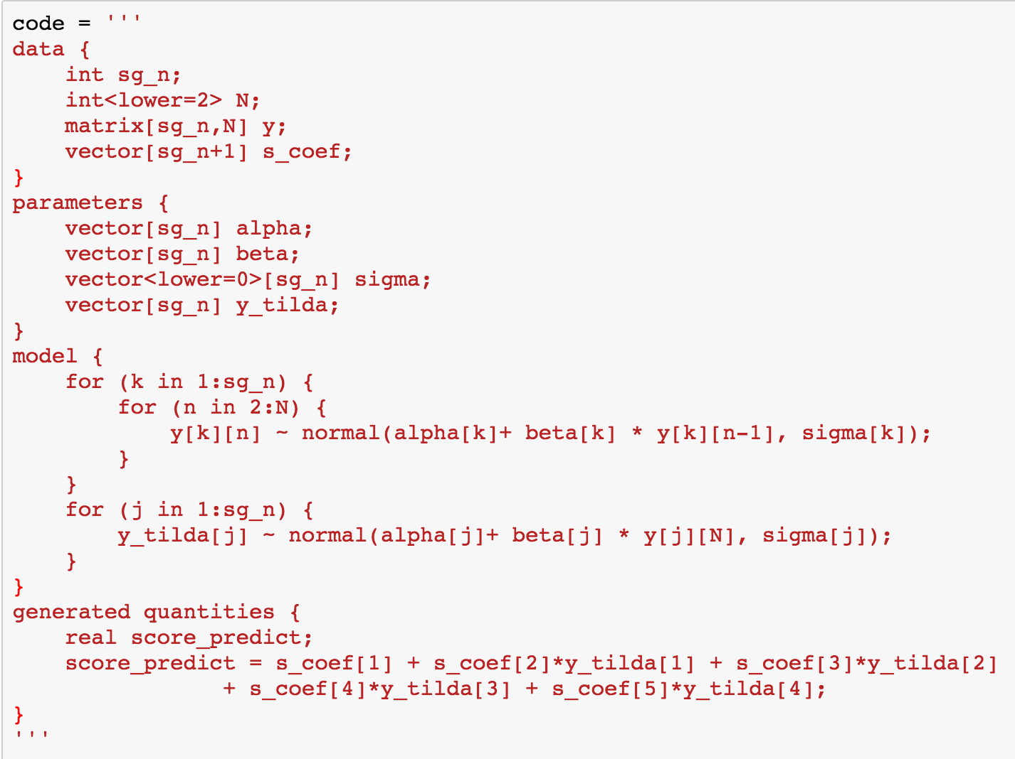
Time-Series Forecasting

Slide 26
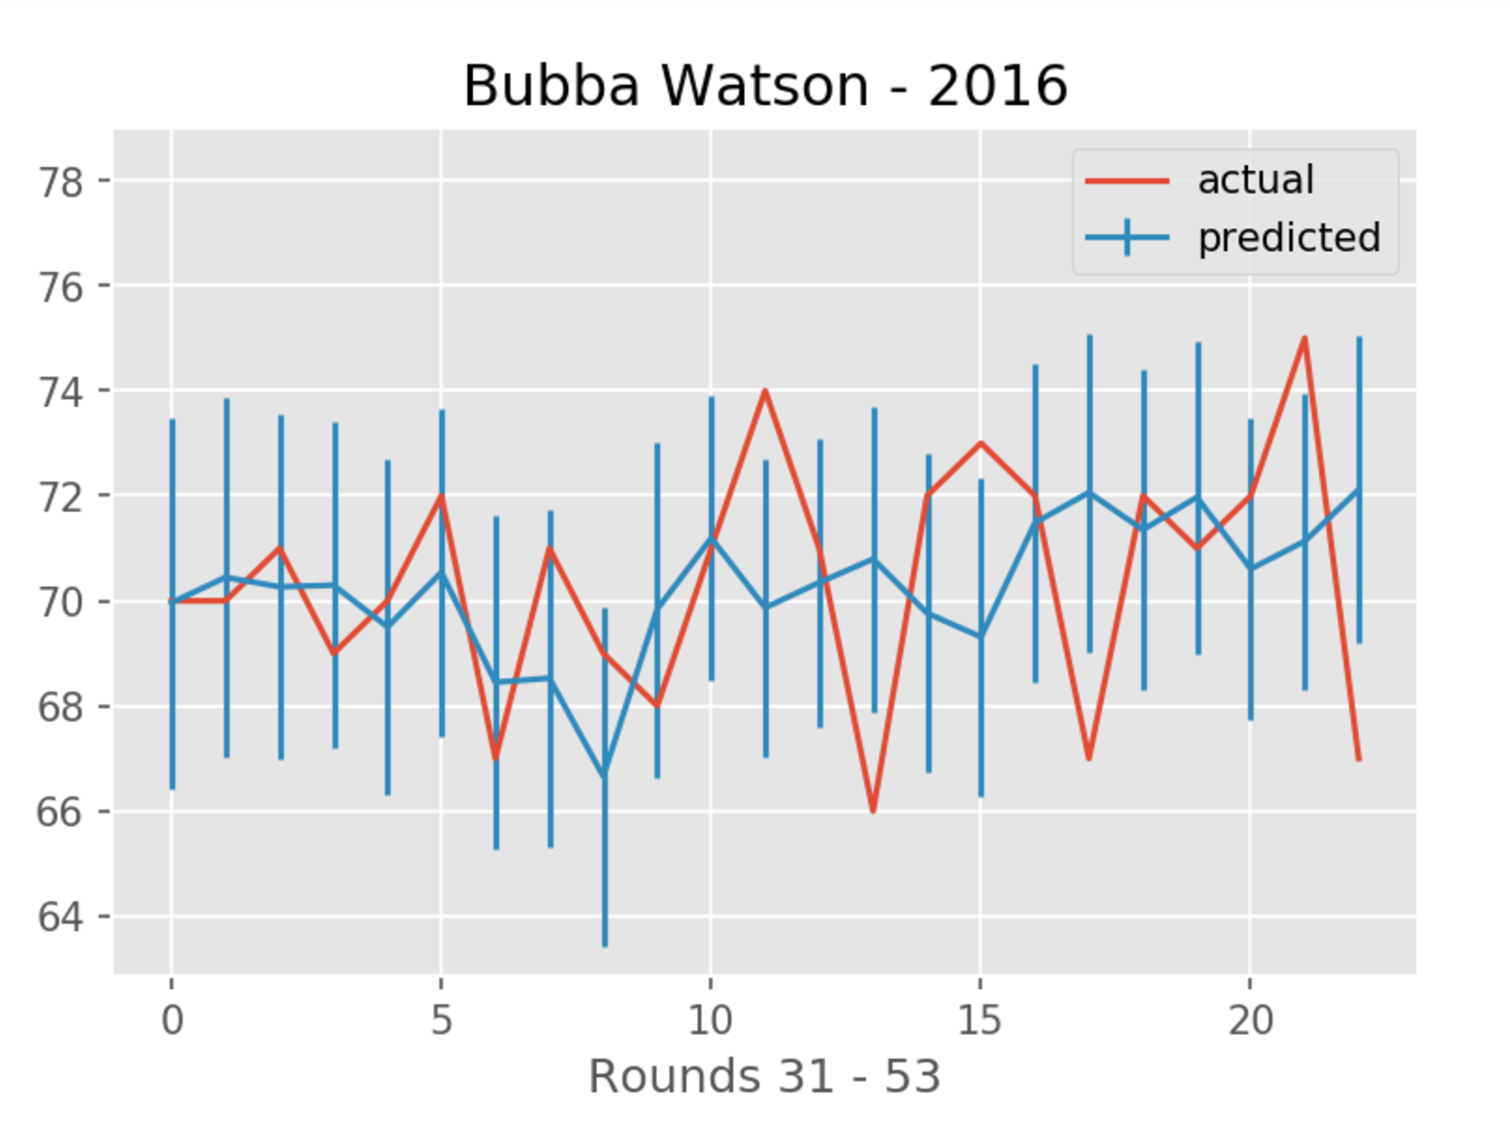

Slide 27
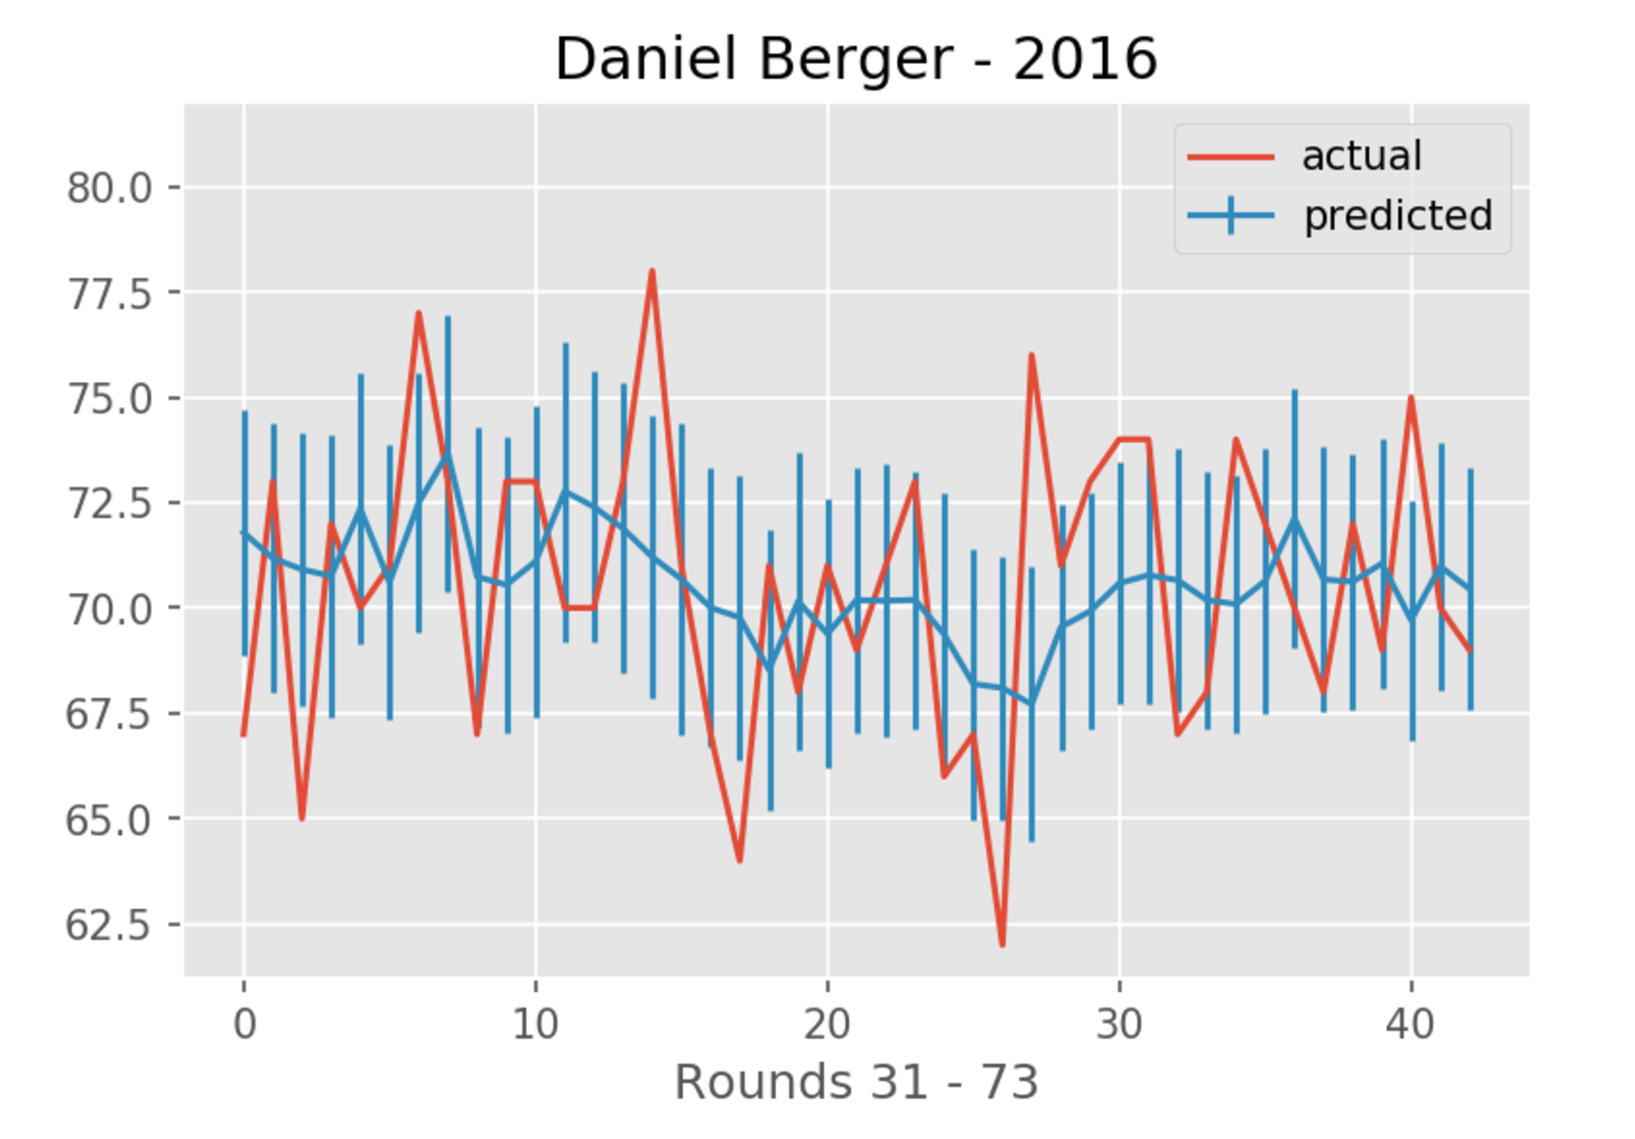

Slide 28
